Slide 1

HIT3016 - SOFTWARE TEAM PROJECT
Tremors with Leap Motion
Team member:
Daniel CORSALETTI
Shengwei LI
Minh Duc NGUYEN
Joshua STOPPER
Tran Xuong TRAN

Slide 2
The Team
Team leader | Joshua Stopper
Documentation | Daniel Corsaletti
Research | Tran Xuong Tran
Testing | Shengwei Li
Technical support | Minh Duc Nguyen

Slide 3
Project Overview
Our client Dr. Phillip Michael is a surgeon for the Royal Victorian Eye & Ear Hospital
Dr. Michael discovered the Leap Motion controller nearly a year ago
Wants to be able to detect tremors in doctors and patients hands in a non invasive and costly manner
Wants to utilize the Leap Motion Controller to accomplish this

Slide 4
Scope
A prove of concept
Visualize user hand movement
Convert hand movement to 4 different output:
Velocity
Amplitude
Hertz
Acceleration

Slide 5
Contributions
Members | Tasks
Joshua Stopper | Validate valid palm positions
Daniel Corsaletti | Implement Test Plan
Tran Xuong Tran | SRS Documents
Shengwei Li | DP and SRS Documents
Minh Duc Nguyen | Design Interface, form validations Technical Manuals

Slide 6
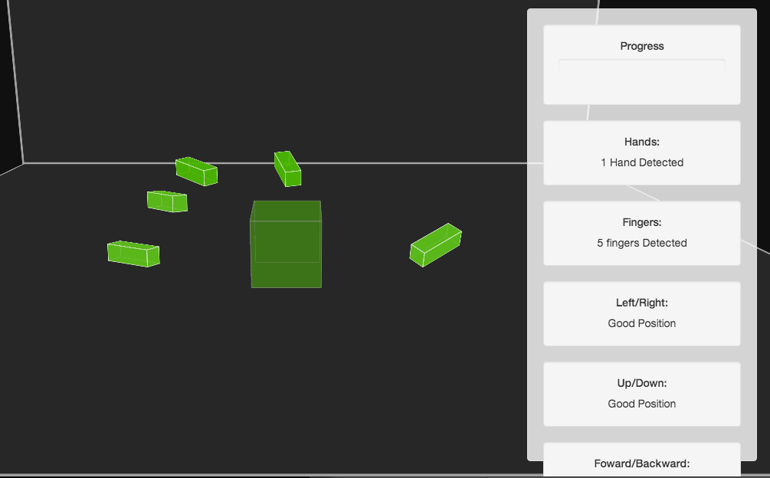
Proposed Solution

Slide 7
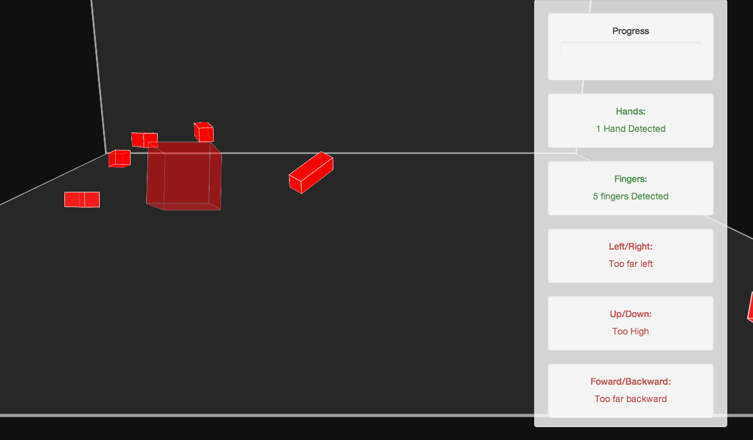
Proposed Solution

Slide 8
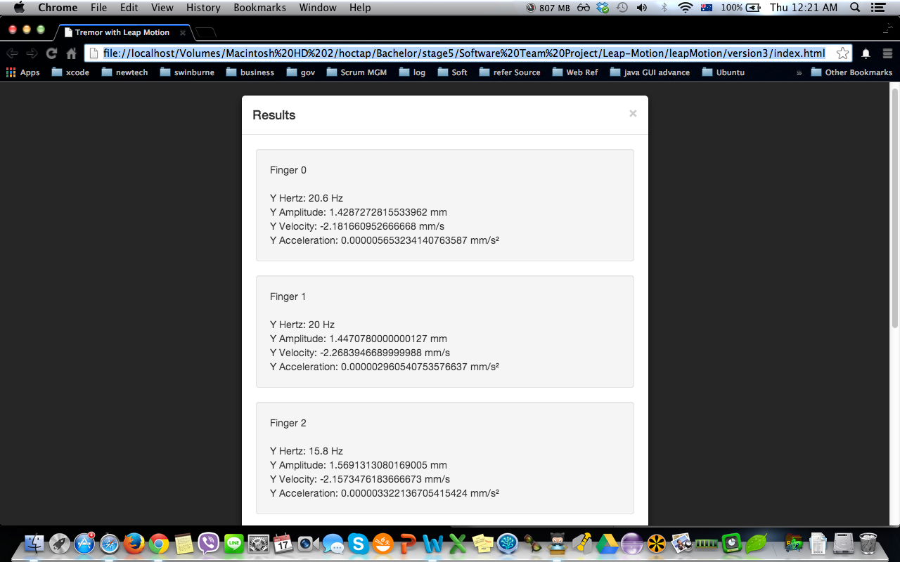
Proposed Solution

Slide 9
Usability Testing
User d

Slide 10
Function Testing

Slide 11
Future Plan

Slide 12
QUESTIONS!!!

